Slide 1

SHREE RAMSWAROOP MEMORIAL UNIVERSITY
Assignment:-7
Java Enterprise Edition Lab - 07
Submitted to:
Submitted by:
Vidushi Srivastava
Mukesh Prajapati
Btech (Cse Industry integrated)
Roll No – 202410101230007

Slide 2
1. Create a JPA Entity Class for Task
Define a JPA entity that represents a task in your application. This class should be annotated with JPA annotations to map it to a database table.
Example: Task Entity Class
import javax.persistence.Entity;
import javax.persistence.Id;
import javax.persistence.GeneratedValue;
import javax.persistence.GenerationType; import javax.persistence.Column;
import javax.persistence.Table; import java.time.LocalDate;
@Entity
@Table(name = "tasks") public class Task {
@Id
@GeneratedValue(strategy = GenerationType.IDENTITY) private Long id;
@Column(nullable = false) private String title;
@Column(nullable = false) private String description;
@Column(nullable = false) private LocalDate deadline;

Slide 3
@Column(nullable = false)
private String priority;
// Getters and Setters
public Long getId() { return id; }
public void setId(Long id) { this.id = id; }
public String getTitle() { return title; }
public void setTitle(String title) { this.title = title; }
public String getDescription() { return description; }
public void setDescription(String description) { this.description = description; }
public LocalDate getDeadline() { return deadline; }
public void setDeadline(LocalDate deadline) { this.deadline = deadline; }
public String getPriority() { return priority; }
public void setPriority(String priority) { this.priority = priority; }
}

Slide 4
2. Develop a Servlet to Handle Task Creation
Create a servlet to handle the task creation form submission. This servlet should use JPA to persist the task data into the database.
Example: Task Creation Servlet
import javax.servlet.ServletException;
import javax.servlet.annotation.WebServlet; import javax.servlet.http.HttpServlet;
import javax.servlet.http.HttpServletRequest;
import javax.servlet.http.HttpServletResponse; import javax.persistence.EntityManager;
import javax.persistence.EntityManagerFactory; import javax.persistence.Persistence;
import java.io.IOException;
import java.time.LocalDate;
@WebServlet("/createTask")
public class CreateTaskServlet extends HttpServlet { private EntityManagerFactory emf;
@Override
public void init() throws ServletException { super.init();
emf = Persistence.createEntityManagerFactory("task-manager-pu");
}
@Override
protected void doPost(HttpServletRequest request, HttpServletResponse response) throws ServletException, IOException {
String title = request.getParameter("title");

Slide 5
String description = request.getParameter("description");
LocalDate deadline = LocalDate.parse(request.getParameter("deadline")); String priority = request.getParameter("priority");
// Validate input (example validation)
if (title == null || title.trim().isEmpty() ||
description == null || description.trim().isEmpty() || deadline == null ||
priority == null || priority.trim().isEmpty()) {
request.setAttribute("error", "All fields must be filled out.");
request.getRequestDispatcher("/WEB-INF/jsp/createTask.jsp").forward(request, response); return;
}
// Create and persist the task
EntityManager em = emf.createEntityManager(); em.getTransaction().begin();
Task task = new Task(); task.setTitle(title);
task.setDescription(description);
task.setDeadline(deadline); task.setPriority(priority);
em.persist(task);
em.getTransaction().commit(); em.close();
response.sendRedirect("taskList"); // Redirect to task list or confirmation page
}

Slide 6
@Override
public void destroy() {
emf.close(); super.destroy();
}
}
3. Configure JPA
Ensure that your JPA configuration is set up properly. This involves configuring persistence.xml or equivalent configuration in your application.
Example: persistence.xml
<persistence xmlns="http://xmlns.jcp.org/xml/ns/persistence"
xmlns:xsi="http://www.w3.org/2001/XMLSchema-instance"
xsi:schemaLocation="http://xmlns.jcp.org/xml/ns/persistence
http://xmlns.jcp.org/xml/ns/persistence/persistence_2_1.xsd" version="2.1">
<persistence-unit name="task-manager-pu">
<provider>org.hibernate.jpa.HibernatePersistenceProvider</provider>
<class>com.example.Task</class>
<properties>
<property name="javax.persistence.jdbc.driver" value="org.postgresql.Driver"/>
<property name="javax.persistence.jdbc.url" value="jdbc:postgresql://localhost:5432/taskdb"/>
<property name="javax.persistence.jdbc.user"
value="dbuser"/>
<property name="javax.persistence.jdbc.password" value="dbpassword"/>
<property name="hibernate.dialect"

Slide 7
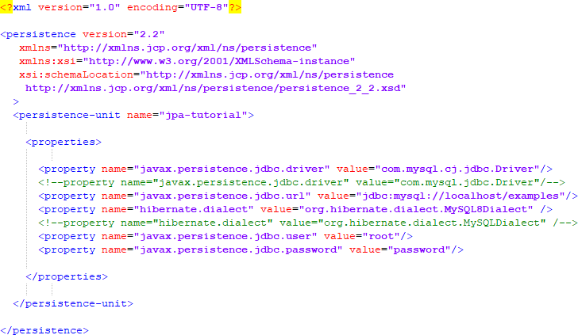
value="org.hibernate.dialect.PostgreSQLDialect"/>
<property name="hibernate.hbm2ddl.auto" value="update"/>
</properties>
</persistence-unit>
</persistence>

